Slide 1
NEWP Kayak Essentials Class
Common Types of Kayaks
Updated January 11, 2024

Slide 2
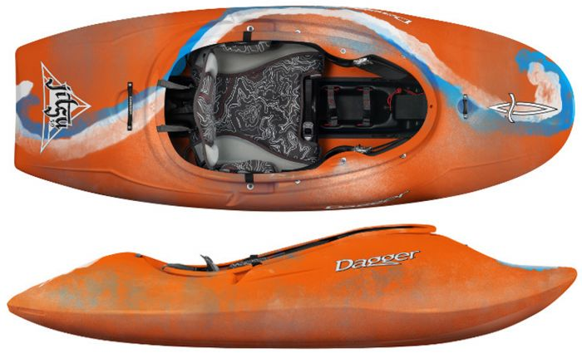
Whitewater Kayaks
Common characteristics:
High rocker/ highly maneuverable
Very “technical”
Different types:
Downriver boats
Playboats
Creek boats
Playboat

Slide 3
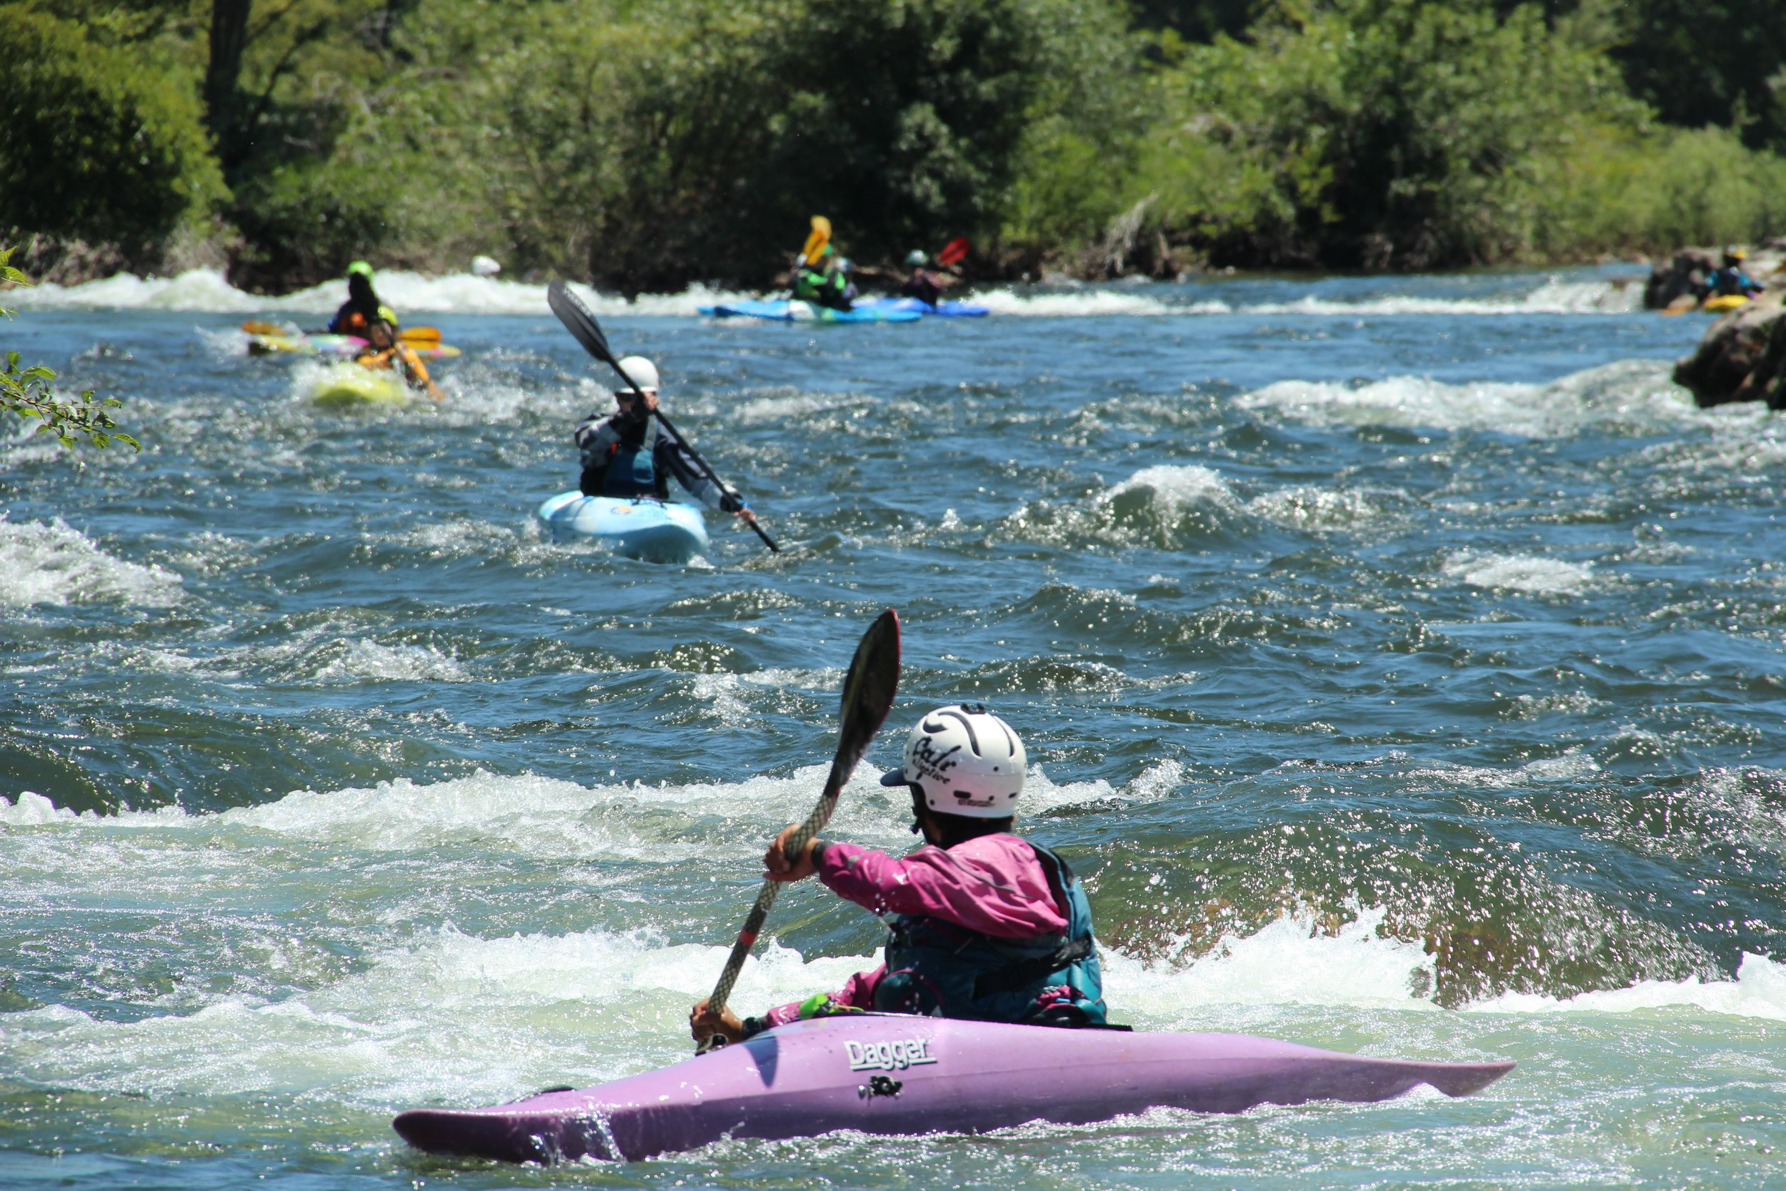
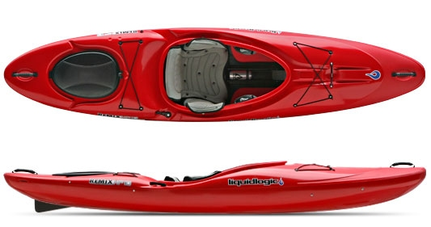
Crossover Kayak
“Typical” (Mamba)

Slide 4
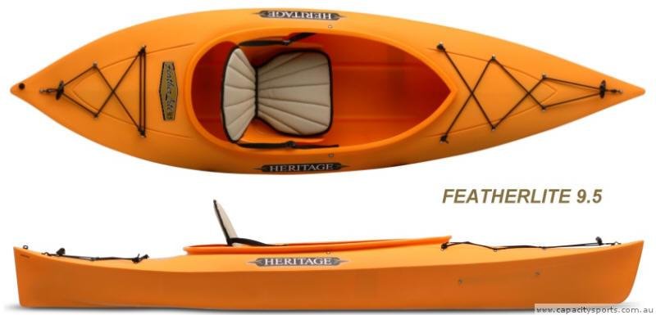
Recreational Kayak (“Rec” boat)
Common characteristics:
Less than 14-foot length
Highly maneuverable/ difficult tracking
Large cockpit opening
Basic outfitting
Minimal floatation
Different types:
May have back bulkhead
Broad variety; rapidly changing

Slide 5
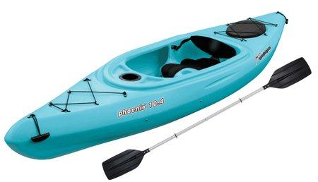
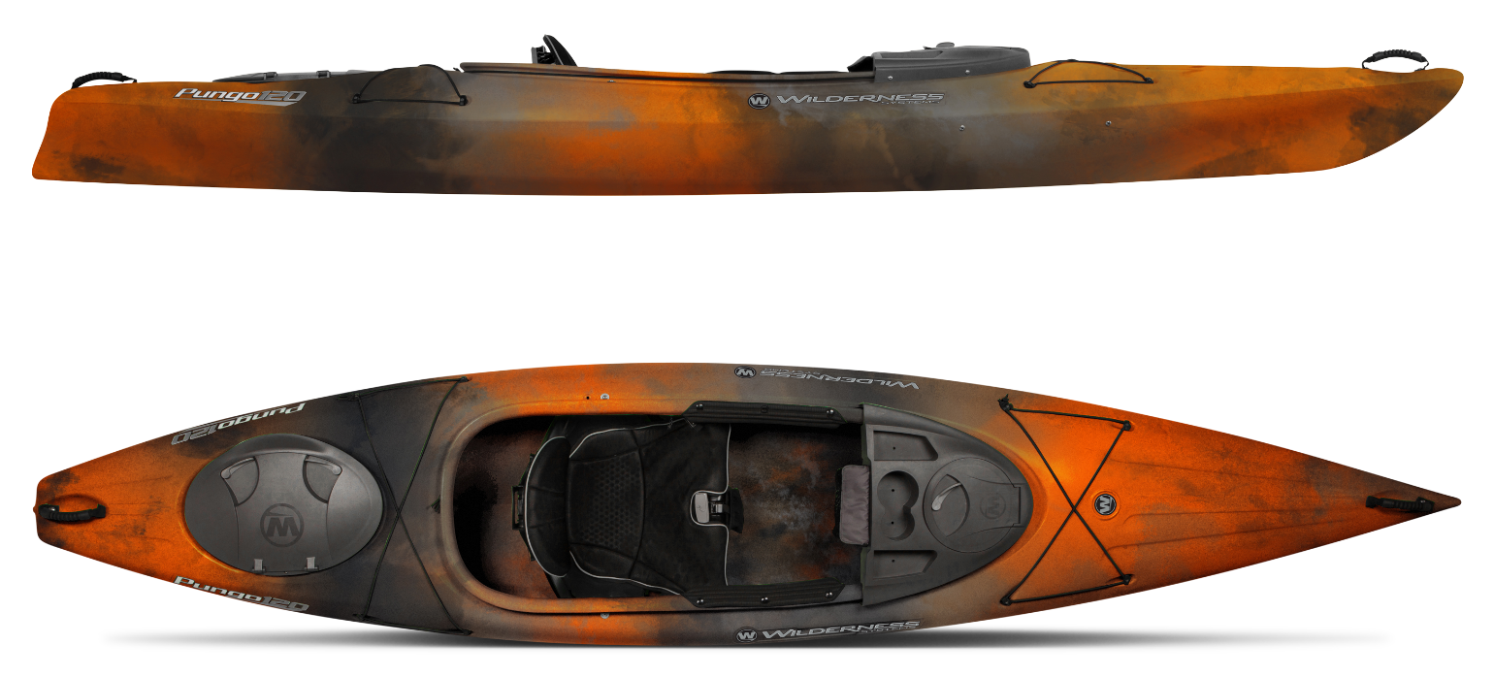
Pelican
Pungo

Slide 6
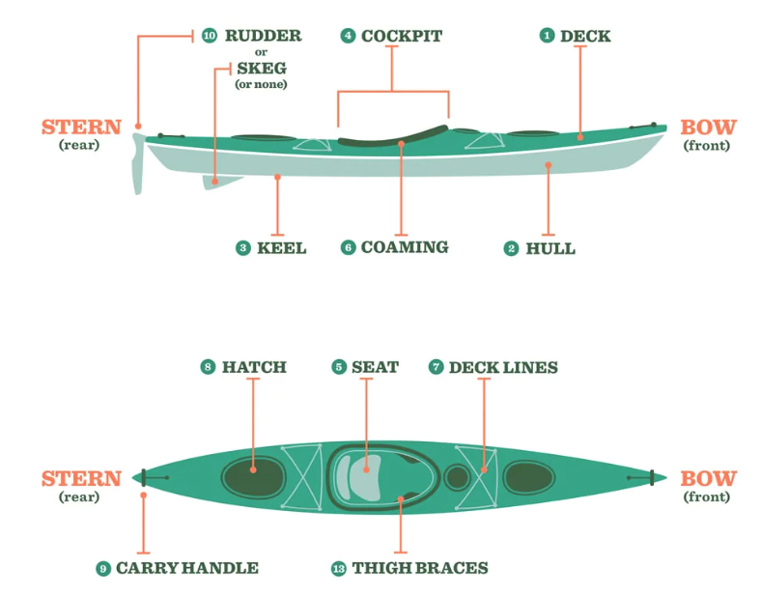
Sea Kayak Anatomy

Slide 7
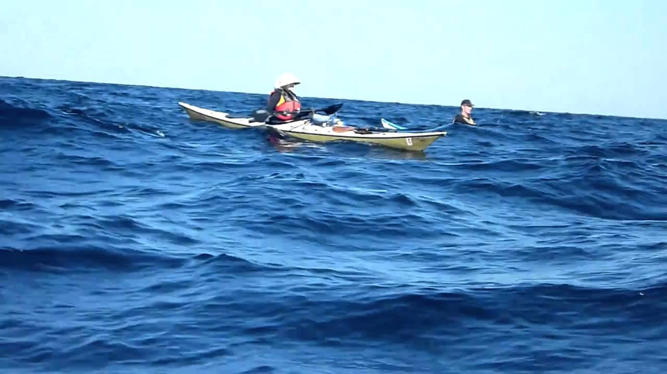
Sea Kayak
Common characteristics:
Little rocker/ track very straight
Less maneuverable
16-feet or longer
Cockpit size to accommodate skirt
Sealed fore and aft bulkheads
Outfitted for gear and rescue

Slide 8
Tempest 170
P&H Cetus

Slide 9
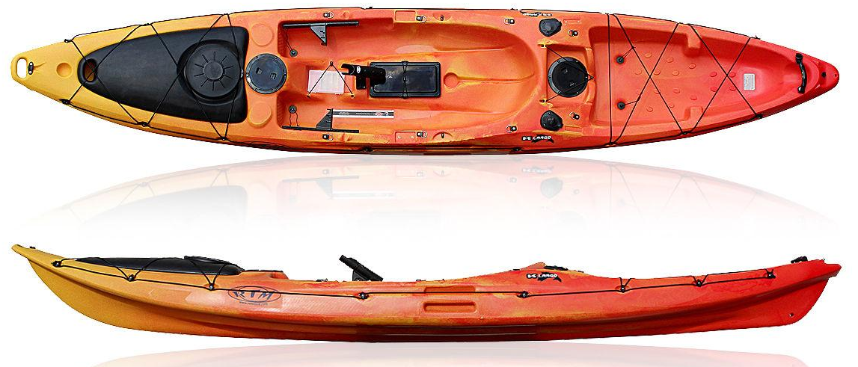
Sit-On-Top Kayak
Common characteristics:
Moderate maneuverability
Generously outfitted
Very stable
Heavy to lift and transport
Different types:
Some with specific uses (touring, fishing, photography)
Some with propulsion devices

Slide 10
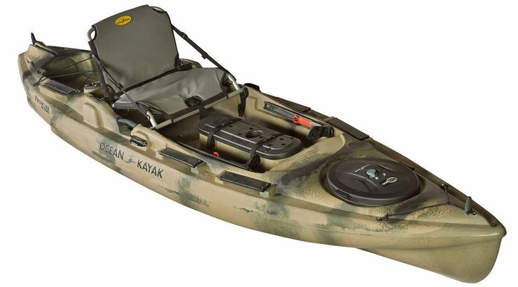
Fishing Kayak

Slide 11
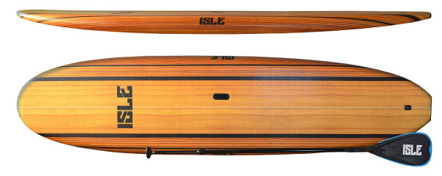
Stand Up Paddle Board (SUP)

Slide 12
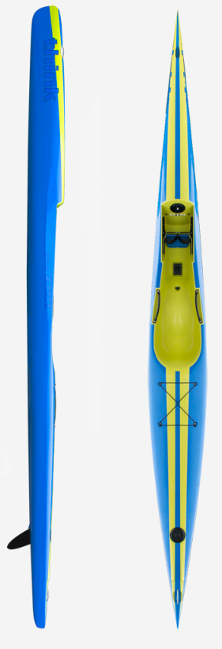
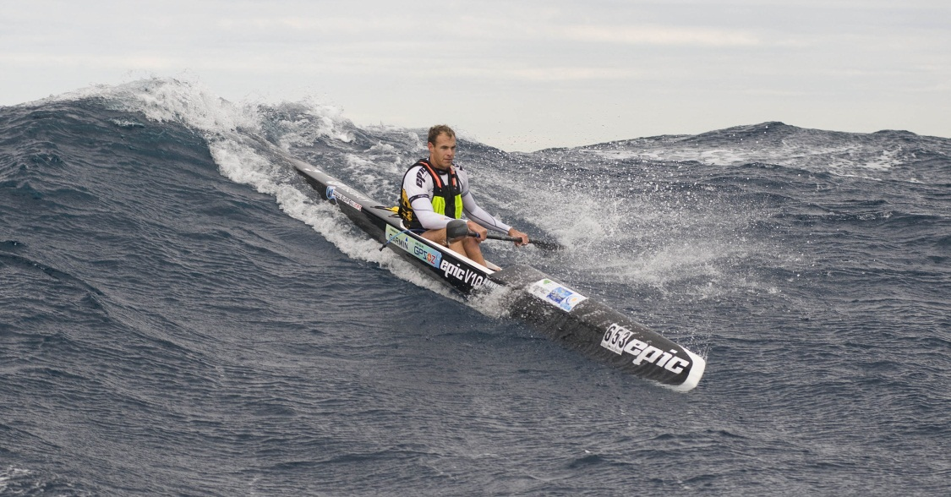
Surf Ski

Slide 13
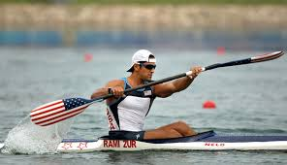
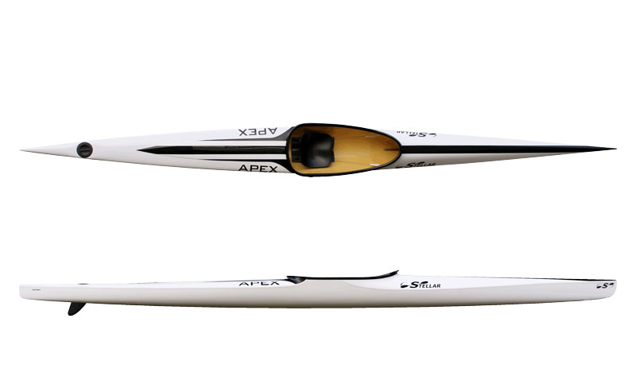
Olympic ICF
(International Canoe Federation)
Sprint Canoe/Kayak
Marathon Canoe/Kayak

Slide 14
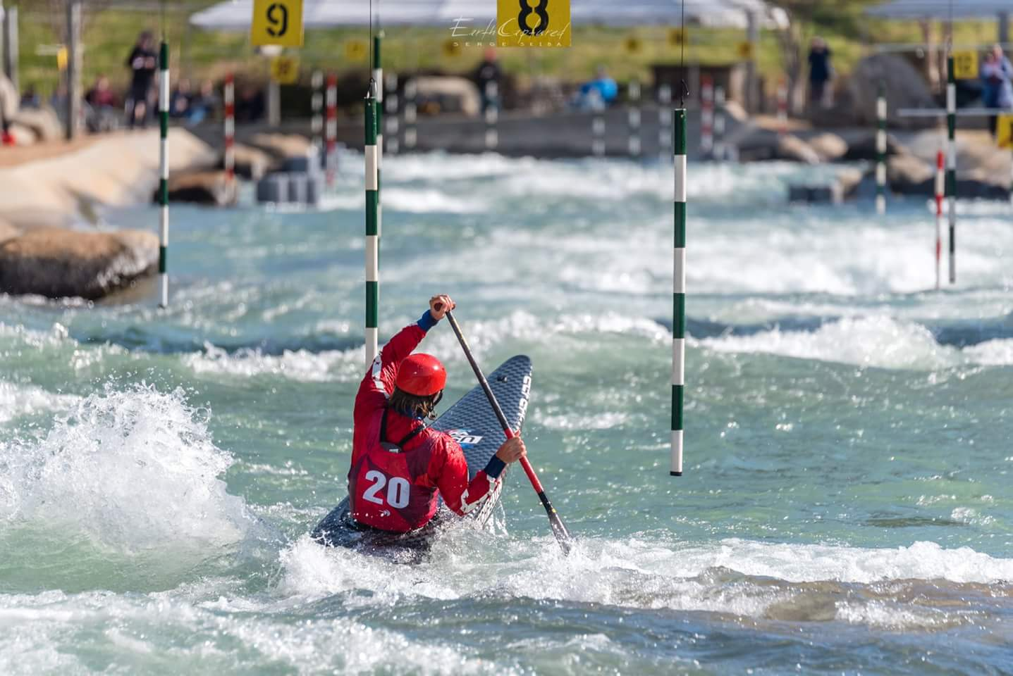
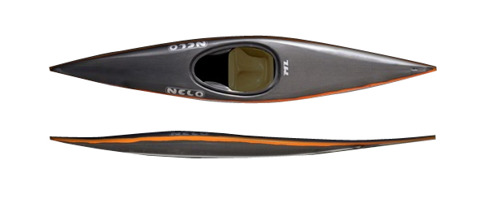
Olympic Slalom

